Slide 1

Module-2
Hadoop Distributed System

Slide 2
Outline
Hadoop - Basics
HDFS
Goals
Architecture
Other functions

Slide 3
Hadoop - Why ?
Need to process huge datasets on large clusters of computers
Very expensive to build reliability into each application
Nodes fail every day
Failure is expected, rather than exceptional
The number of nodes in a cluster is not constant
Need a common infrastructure
Efficient, reliable, easy to use
Open Source, Apache Licence

Slide 4
Who uses Hadoop?
Amazon/A9
Facebook
Google
New York Times
Veoh
Yahoo!
…. many more

Slide 5
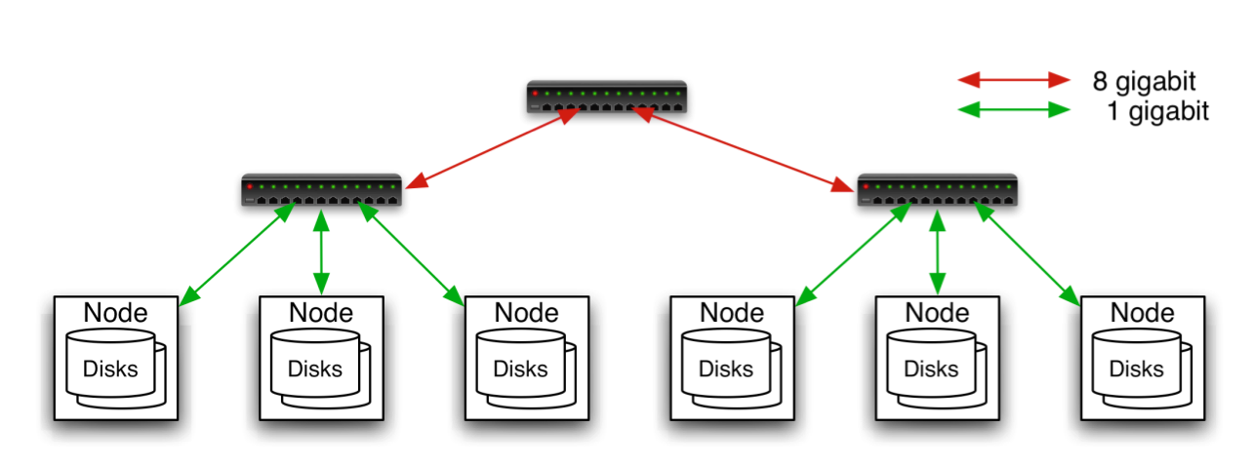
Commodity Hardware
Aggregation switch
Rack switch
Typically in 2 level architecture
Nodes are commodity PCs
30-40 nodes/rack
Uplink from rack is 3-4 gigabit
Rack-internal is 1 gigabit

Slide 6

Goals of HDFS
Very Large Distributed File System
10K nodes, 100 million files, 10PB
Assumes Commodity Hardware
Files are replicated to handle hardware failure
Detect failures and recover from them
Optimized for Batch Processing
Data locations exposed so that computations can move to where data resides
Provides very high aggregate bandwidth

Slide 7
Distributed File System
Single Namespace for entire cluster
Data Coherency
Write-once-read-many access model
Client can only append to existing files
Files are broken up into blocks
Typically 64MB block size
Each block replicated on multiple DataNodes
Intelligent Client
Client can find location of blocks
Client accesses data directly from DataNode

Slide 8

HDFS Architecture

Slide 9
Functions of a NameNode
Manages File System Namespace
Maps a file name to a set of blocks
Maps a block to the DataNodes where it resides
Cluster Configuration Management
Replication Engine for Blocks

Slide 10
NameNode Metadata
Metadata in Memory
The entire metadata is in main memory
No demand paging of metadata
Types of metadata
List of files
List of Blocks for each file
List of DataNodes for each block
File attributes, e.g. creation time, replication factor
A Transaction Log
Records file creations, file deletions etc

Slide 11
DataNode
A Block Server
Stores data in the local file system (e.g. ext3)
Stores metadata of a block (e.g. CRC)
Serves data and metadata to Clients
Block Report
Periodically sends a report of all existing blocks to the NameNode
Facilitates Pipelining of Data
Forwards data to other specified DataNodes

Slide 12
Block Placement
Current Strategy
One replica on local node
Second replica on a remote rack
Third replica on same remote rack
Additional replicas are randomly placed
Clients read from nearest replicas
Would like to make this policy pluggable

Slide 13
Heartbeats
DataNodes send hearbeat to the NameNode
Once every 3 seconds
NameNode uses heartbeats to detect DataNode failure

Slide 14
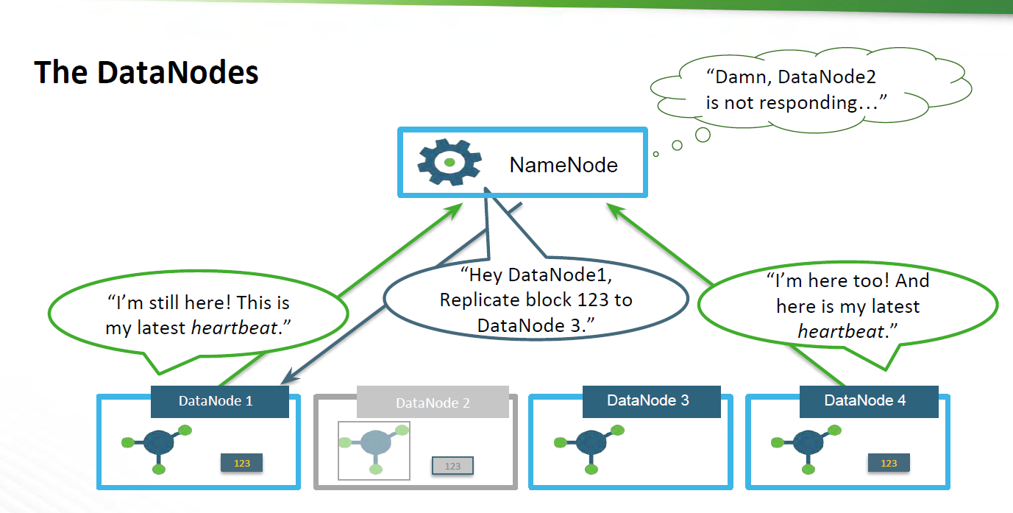

Slide 15
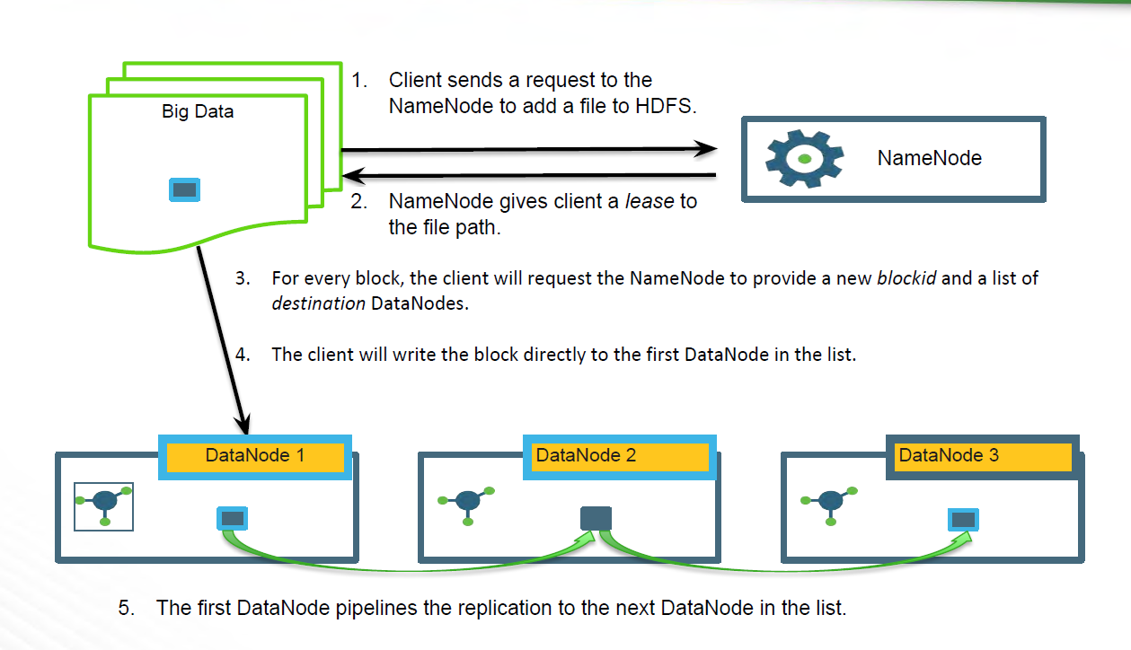

Slide 16
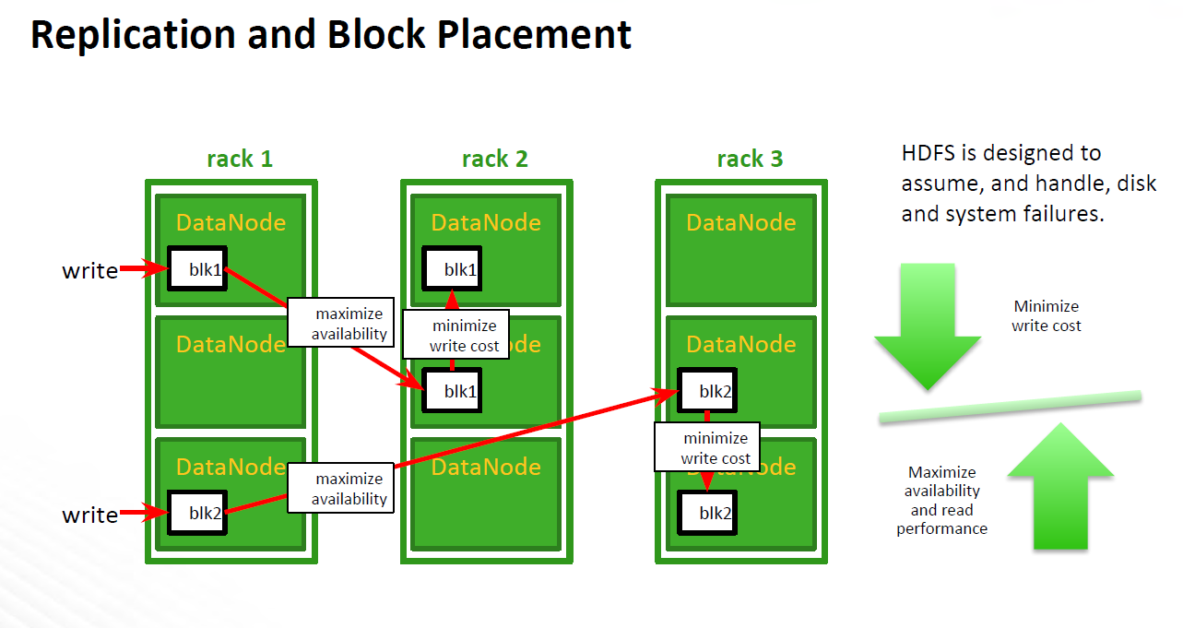

Slide 17
Replication Engine
NameNode detects DataNode failures
Chooses new DataNodes for new replicas
Balances disk usage
Balances communication traffic to DataNodes

Slide 18
Data Correctness
Use Checksums to validate data
Use CRC32
File Creation
Client computes checksum per 512 bytes
DataNode stores the checksum
File access
Client retrieves the data and checksum from DataNode
If Validation fails, Client tries other replicas

Slide 19
NameNode Failure
A single point of failure
Transaction Log stored in multiple directories
A directory on the local file system
A directory on a remote file system (NFS/CIFS)
Need to develop a real Hign Availibility solution

Slide 20
Data Pieplining
Client retrieves a list of DataNodes on which to place replicas of a block
Client writes block to the first DataNode
The first DataNode forwards the data to the next node in the Pipeline
When all replicas are written, the Client moves on to write the next block in file

Slide 21
Rebalancer
Goal: % disk full on DataNodes should be similar
Usually run when new DataNodes are added
Cluster is online when Rebalancer is active
Rebalancer is throttled to avoid network congestion
Command line tool

Slide 22
Secondary NameNode
Copies FsImage and Transaction Log from Namenode to a temporary directory
Merges FSImage and Transaction Log into a new FSImage in temporary directory
Uploads new FSImage to the NameNode
Transaction Log on NameNode is purged

